Slide 1
PLYWOOD · LOYALTY PROGRAMME
Running your loyalty programme
A walkthrough for brand admins: what your customers see, your admin panel, and how points are counted
Rocky -
Notes:
Welcome. Today: how your customers earn and redeem points, the admin panel you'll use every day, how the points maths works, and the tricky cases. We finish with a live demo on a phone and the admin panel, then questions.

Slide 2
FOR YOUR CUSTOMERS
Four steps, no app to install
1
2
3
4
Scan
Verify
Earn
Redeem
The QR code on the product or at the shop opens a web page.
Once per phone: a 6-digit SMS code, then name and trade.
10 points per scan. Scans before verifying wait as "pending".
Points buy a reward. The customer gets a voucher code to show at your store.
Notes:
The QR code is the same everywhere, so the server does the anti-abuse work: waiting time between scans and a daily limit. A customer's account is their phone number, for your brand only. The same number with another brand is a separate account.

Slide 3
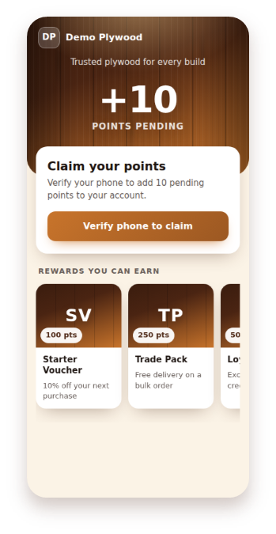
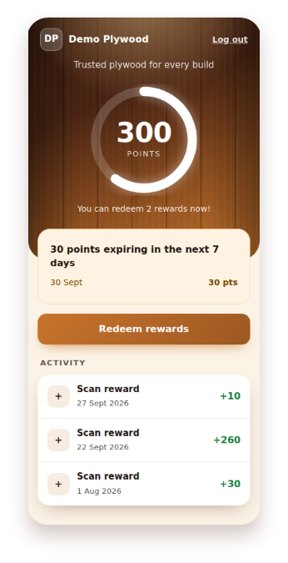
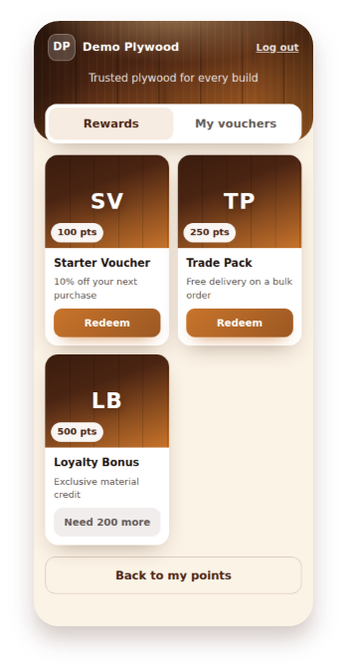
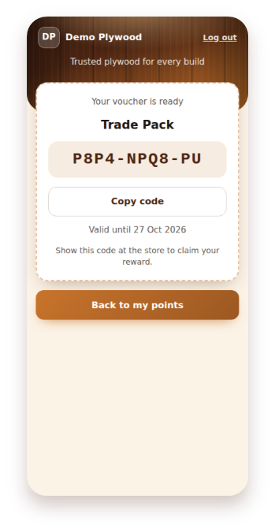
What your customers see
Scan result
My points
Rewards
Voucher code
Notes:
Left to right. After a scan without logging in, points show as pending and are saved on that phone for 30 days. My points: the ring shows the balance and how far to the next reward, points expiring in the next 7 days, and all activity. Rewards: cost in points, or how many more are needed. Voucher: a code like K7MQ-3XRD-9P that the customer shows at your counter, valid 30 days. Colours, name and logo are yours, set in Settings.

Slide 4
THE RULES, BY DEFAULT
Five numbers run the programme
10
10 min
5
60 d
30 d
points per scan
earning scans a day (India time)
points expire
voucher validity
wait after a scan that earned
You can change every one of these in Settings. Changes apply to future scans and vouchers only, never to the past.
Notes:
Also: pending points (scanned before verifying) wait 30 days, and customers are warned 7 days before points expire. Each batch of points has its own expiry, 60 days from the day it was added.

Slide 5
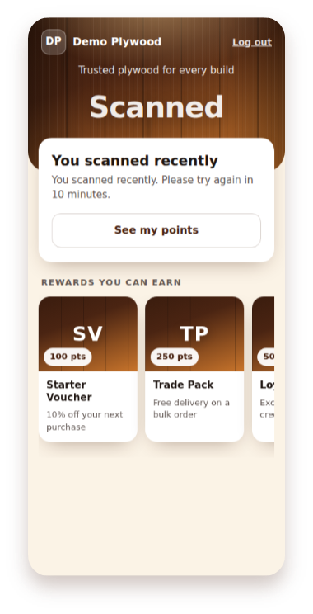
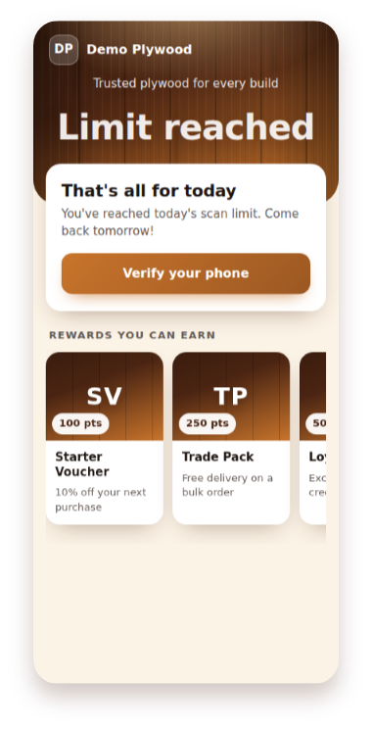
Scans that earn nothing
Scanning again within 10 minutes, or more than 5 times a day, is recorded but earns no points. The customer sees a friendly message.
A refused scan does not restart the 10-minute wait.
Refused scans do not appear in the points ledger. If a customer says "I scanned but got nothing", this is almost always why.
Notes:
Left: scanned recently, the message says how long is left. Right: daily limit, resets at midnight India time. The daily limit counts across all of a customer's phones once they verify; the 10-minute wait is per phone.

Slide 6
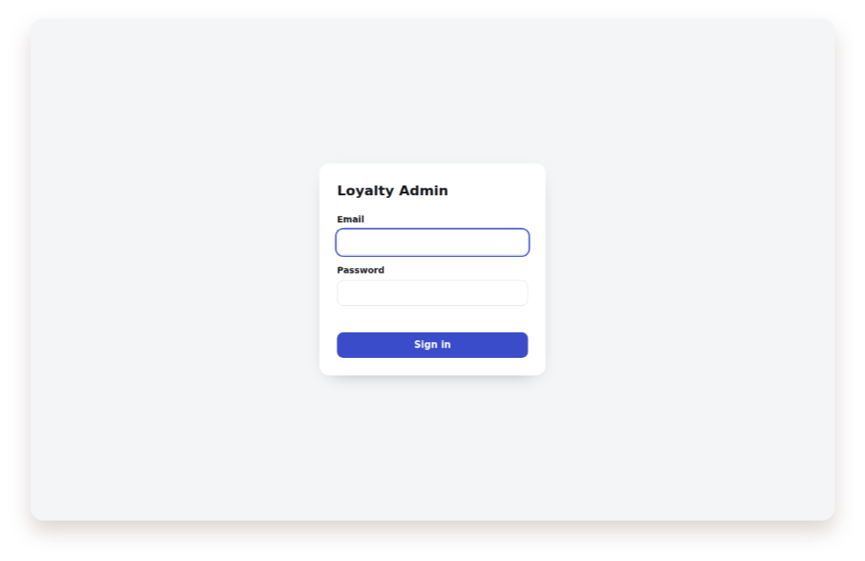
YOUR ADMIN PANEL
One login, five screens
Screen | What you do there
Users | Find a customer, see balance, adjust points
Redemptions | Fulfil or cancel vouchers
Ledger | Every point movement
Rewards | Catalogue, cost, stock
Settings | Branding, categories, rules
Every change is recorded with your name, the time and your reason.
Notes:
Open https://[your domain]/admin on a computer or phone. You only ever see your own brand. Sign-in: 5 wrong passwords in 15 minutes locks the account for the rest of those 15 minutes. A session lasts 12 hours. SMS settings are managed by the platform owner and are read-only for you.

Slide 7
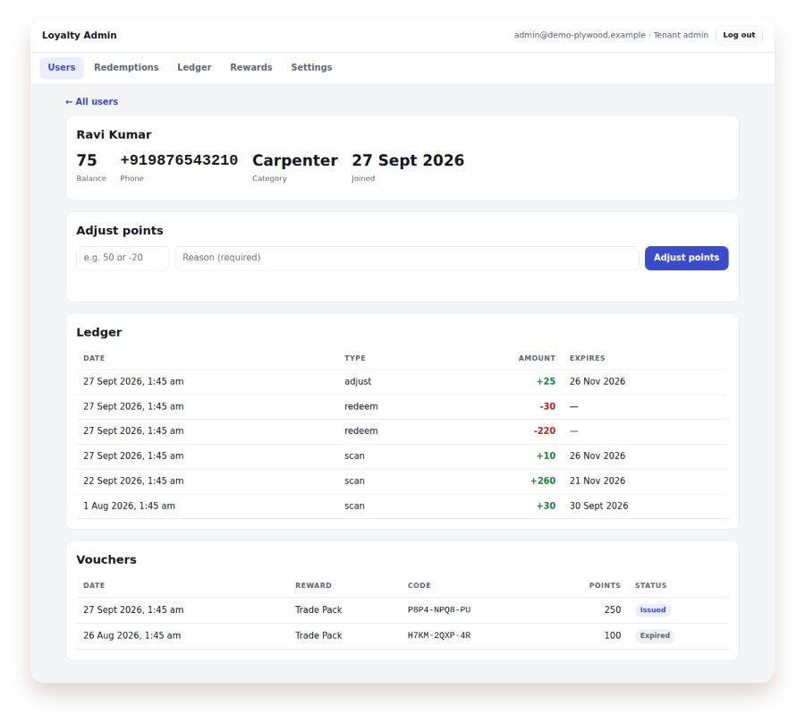
Users and point adjustments
Search by any part of a phone number or name. Open a customer to see balance, ledger and vouchers.
Adjust points
Positive number adds, negative removes
A reason is required (3–200 characters)
Added points expire like any other: 60 days
Removing takes the oldest points first
The balance cannot go below zero
Notes:
Typical uses: a goodwill gesture, correcting a mistake, or moving points when a customer gets a new phone number: remove from the old account, add to the new one, same reason on both. Customers see adjustments in their activity as "Adjustment".

Slide 8
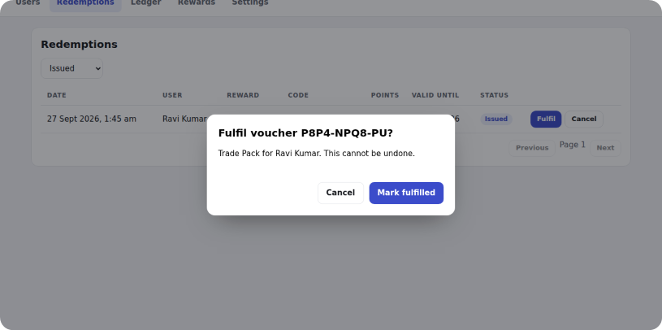
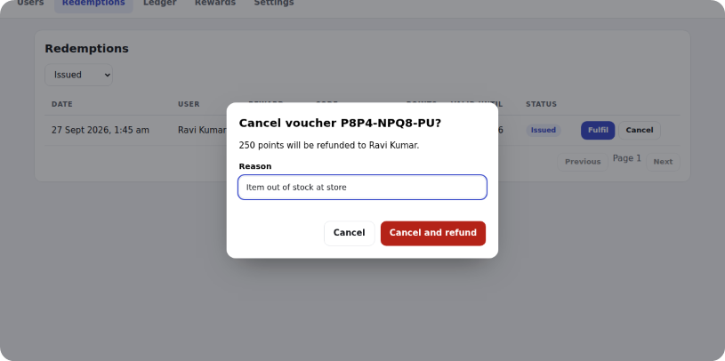
At the counter: fulfil or cancel
Fulfil
Cancel
The customer shows the code and receives the reward. Open Redemptions → Issued and fulfil it. Final: cannot be undone.
The reward cannot be given. Needs a reason. Points go back as a new batch valid 60 days; stock goes up by 1.
Notes:
Only Issued vouchers can be fulfilled or cancelled. Check the code matches before fulfilling. Fulfilled by mistake? It cannot be reversed: if the customer did not get the reward, give the points back with an adjustment and a reason.

Slide 9
HOW POINTS ARE CALCULATED
Balance = unspent points that have not expired
Every batch of points keeps its own expiry date. Spending uses the oldest points first. Nothing stores a balance: it is always worked out from the ledger, so it can never drift.
Notes:
The ledger is the full history: scan (+), redeem (−), refund (+), adjust (+ or −), expire (−). Lines are never edited or deleted. A batch stops counting at its exact expiry time; every night at 00:30 India time a job writes the matching "expire" line. It is safe to run twice.

Slide 10
Worked example
Date | Ledger line | Expires | Left on this batch
1 Jan | scan +10 | 2 Mar | 10 → 0
5 Jan | scan +10 | 6 Mar | 10 → 5
20 Jan | adjust +20 (goodwill) | 20 Mar | 20
1 Feb | redeem −15 | — | takes 10 from 1 Jan, 5 from 5 Jan
1 Feb: balance 25
7 Mar: balance 20
Cancel on 10 Feb: 40
0 + 5 + 20
the 5 left from 5 Jan expire
refund +15, new expiry 11 Apr
Notes:
On 3 March the 1 Jan batch passes its expiry, but it was fully spent, so nothing expires. On 7 March the 5 Jan batch expires with 5 left, so the nightly job writes expire −5. If you cancel the 1 Feb voucher on 10 Feb, the 15 points come back as one new batch with a fresh 60-day expiry, not their original dates.

Slide 11
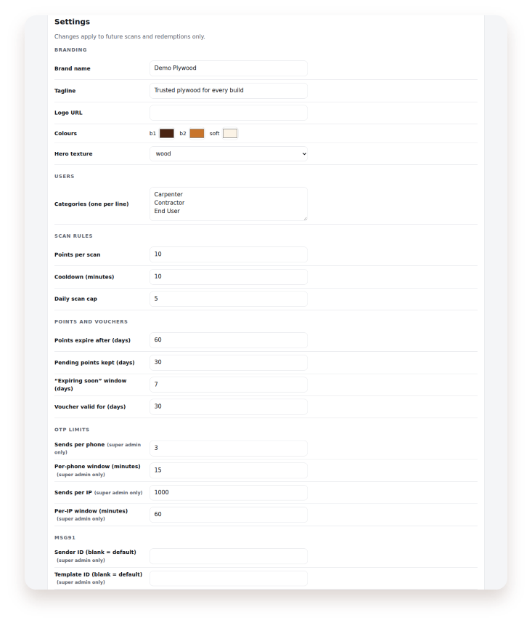
Settings apply from now on
You change | What happens
Points per scan | New scans only. Pending points keep their value.
Points expiry | New batches only; old ones keep their date.
Voucher validity | New vouchers only.
Cooldown, daily cap | From the next scan.
Categories | New sign-ups. Keep at least one.
Name, logo, colours | Immediately in the app.
Notes:
Only the fields you change are saved and logged. Shortening "pending points kept" can make older pending scans unclaimable. Removing a category does not change existing customers. OTP limits and SMS sender settings are platform-owner only.

Slide 12
"Where are my points?"
The customer says | Likely cause
I scanned but got nothing | Within 10 minutes of the last earning scan, or over 5 that day
My pending points didn't come | Verified on a different phone, pending older than 30 days, or that day's limit already reached
My balance dropped | Points expired after 60 days, or an adjustment (check the ledger)
My voucher doesn't work | Expired after 30 days, or already fulfilled
I have two accounts | Two phone numbers are two accounts: move points with adjustments
Notes:
Always start from the customer's ledger in Users. Pending points stay on the phone that scanned: the customer must verify on that same phone to claim them. Each brand's accounts are separate, so a number registered with another brand is a different account.

Slide 13
Vouchers: what is final
Issued
Fulfilled
Cancelled
Expired
Waiting at the counter. The only status you can change.
Final. Mistake? Add the points back with an adjustment.
Final. Points were refunded as a new 60-day batch.
Final, no refund. Goodwill goes through an adjustment.
A double tap on Redeem is still one redemption. Deactivating or restocking a reward does not affect vouchers already issued.
Notes:
Rewards cannot be deleted because vouchers refer to them: untick Active to hide one. Stock goes down 1 per redemption and up 1 per cancel; at 0 the app shows Out of stock.

Slide 14
Your routine and getting help
Every day
Every week
Ask the platform owner
Fulfil vouchers as rewards are handed over
Cancel any you cannot honour, with a reason
Check reward stock
Look at old Issued vouchers
Answer customer queries from the ledger
Locked out (or wait 15 min)
Forgotten password
New admin logins
SMS settings
Do not share your login. Every action is recorded under your name.
Notes:
Platform owner contact: [name, phone, email]. There is no password-reset screen yet, so the platform owner sets a new password for you. All dates in the panel are India time.

Slide 15
Live demo
A customer scans, verifies and earns
Redeems a reward and gets a voucher
You find the customer, fulfil the voucher, adjust points
You change a setting and see it in the app
Then your questions.
Notes:
Follow docs/DEMO_SCRIPT.md. Demo runs on the test setup, where the SMS code is always 000000; say this clearly so nobody expects real SMS today.

